Slide 1
Optimal fishing of an unstructured population Question 2
Hooi Min Tan Grahn

Slide 2
The overarching scope
This problem falls within the broader context of population ecology, natural resource management, and sustainable harvesting practices.
By studying the growth, interactions, and fluctuations of populations, ecologists gain insights into how species thrive, compete, and respond to various environmental factors.
Sustainable management involves maintaining a balance between resource extraction and regeneration to ensure the resource's long-term availability.
Sustainable harvesting practices aim to ensure that the utilization of natural resources does not compromise their availability for future generations. In the context of fishing, this means harvesting fish in a way that allows the population to replenish itself sufficiently.

Slide 3
Specific scope and scientific impact
These problems are of significant interest for science due to their direct implications for ecological sustainability, fisheries management, and biodiversity conservation. Understanding the dynamics of populations subject to harvesting pressure is crucial for maintaining balanced ecosystems and ensuring the long-term viability of natural resources.
In this case, the focus is on modeling the growth of a fish population, considering its intrinsic growth rate, carrying capacity, and how harvesting affects these dynamics. Population ecology helps predict how populations might change over time and how external factors, like harvesting, can impact their sustainability.

Slide 4
Specific questions
The problem pertains to understanding the dynamics of an unstructured fish population that grows according to a specific equation, considering both its natural growth and the impact of harvesting. It aims to determine equilibrium population sizes under different harvesting rates and identify thresholds where the population either reaches extinction or maximizes its yield.
These questions aim to delve into the mathematical modeling, equilibrium conditions, thresholds for extinction, and optimization aspects of harvesting, providing insights into sustainable management practices for natural populations subjected to exploitation.

Slide 5
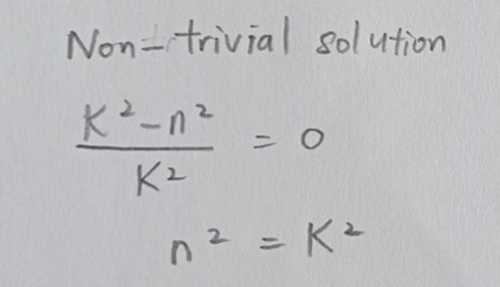
General and specific description of question 2a
An equilibrium is defined as a state where no state variables change.
I solved question 2a by solving equation dn/dt mathematically by assigning dn/dt = 0 and rearranging the equation.
The non trivial solution is

Slide 6
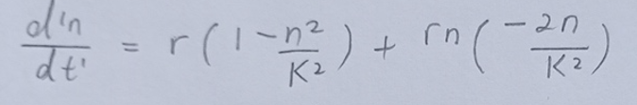
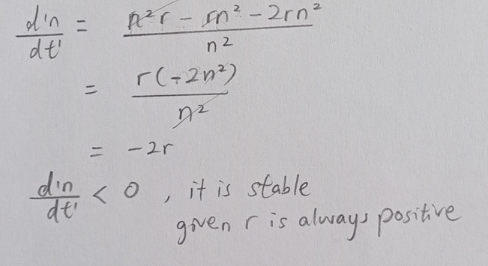
General and specific description of question 2b
To analyse the stability I computed the derivative of the function dn/dt at the equilibrium
by solving d’n/dt’ = 0.
I used product rule to further solve the derivative.
Given n² = K² at equiribrium, An equilibrium n* is stable when f’n < 0.

Slide 7
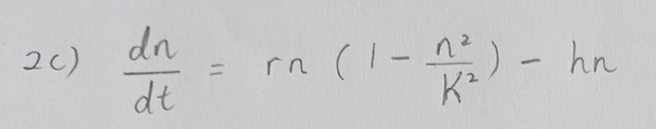
General and specific description of question 2c
The introduction of harvesting at a rate hn modifies the population growth equation. I subtracted the harvesting hn from the total population growth rate. The modified equation becomes:
Harvesting acts as a removal term, reducing the population growth rate by the amount harvested per unit time. This alters the population's growth trajectory over time, potentially leading to changes in equilibrium population size.

Slide 8
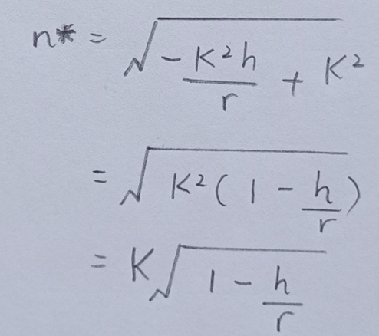
General and specific description of question 2d
I solved 2d equilibrium points by solving dn/dt = 0.
The stable equilibrium occurs when the population growth rate equals the death rate. In the harvested population, this equilibrium is reached when the net growth rate, considering both intrinsic growth and harvesting, is zero. New equilibrium population size (n*) see below,

Slide 9
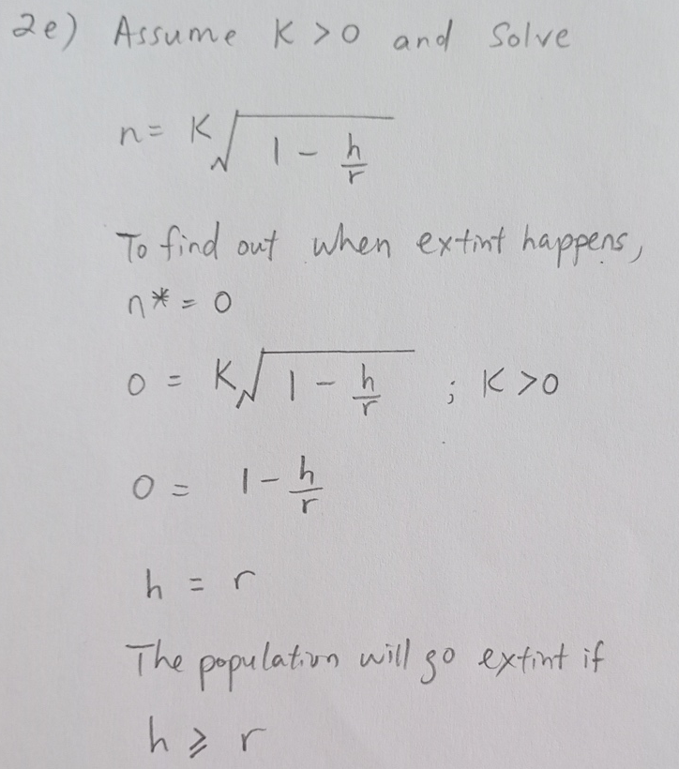
General and specific description of question 2e
The population goes extinct when the harvesting rate exceeds the population's ability to replace itself through natural growth. Mathematically, extinction occurs when the population growth rate becomes negative

Slide 10
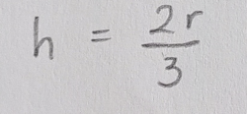
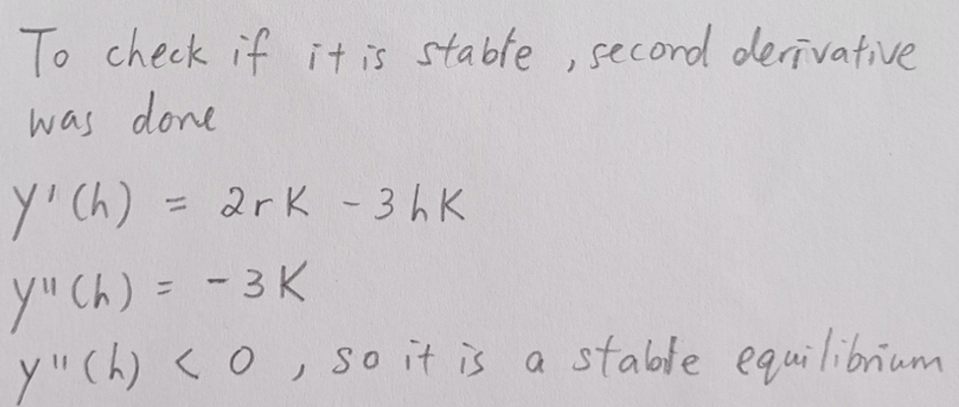
General and specific description of question 2f
The harvesting rate that maximizes the yield occurs when the total harvest is at its maximum.
I solved 2f by defining the yield, the hn*, at equilibrium becomes 0.
I used product rule to mathematically solve the derivative.
The total harvest is

